Slide 1
Going Offline with Progressive Web Apps
Notes:
In fact, this is the core point - Progressive Web Apps are a whole new level of caring about the quality of your end-to-end user experience. If you forget the entire rest of my presentation today, I hope you remember this slide.

Slide 2

Adolfo Benedetti
Github, Twitter: @adben
adolfo.benedetti@gmail.com
Notes:
Introduce yourself here.

Slide 3
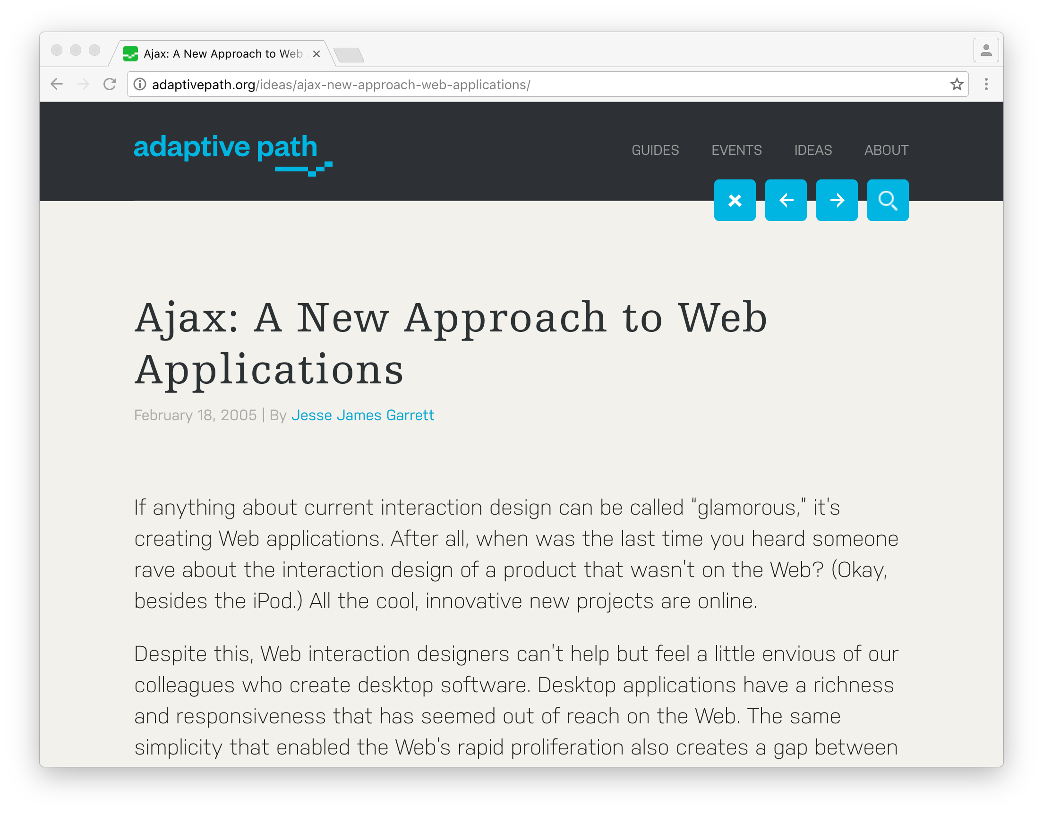
Notes:
…when the pattern of Ajax transformed the web from static pages into dynamic, interactive experiences… when the expectation of user experience went from clicking on the side of a map and waiting a few seconds for it to scroll, to...

Slide 4

Notes:
… a Google Maps experience, with living panning & zoom. You don’t need to spend 30 minutes installing native maps software, and you don’t have to live with a horrible click-and-wait user experience. Of course, thus far this has been more successful in desktop web than in mobile web - Raise your hand if you use google maps on the web on desktop. Now who goes to a browser to get to maps on phone? Thought so.

Slide 5

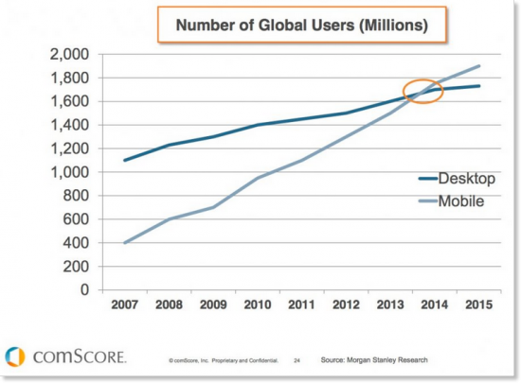
Notes:
In fact, mobile is what is at the bottom of this revolution - the explosion of computing usage in mobile, right after the explosion of the web, has changed the computing landscape again. A year or two ago, depending on which stats you use, mobile computing use overtook desktop use - we now use mobile devices more than desktop computers.

Slide 6
13%
vs.
87%
Mobile web
Apps
Source: comScore Mobile Metrix, U.S., Age 18+, June 2015
Notes:
And in mobile, users spending most of their time in native apps, rather than the web. Only 13% of users’ mobile time is on the mobile web, vs 87% spent in apps, as of last year. Apps are more predictable, and they have some great re-engagement features - like Homescreen icons make it easy to get back to the app, and push notifications that brings users back even when the app is closed.
This slide might make it seem like I could cut my presentation short, say “build native apps”, and go home early. But there’s a flip side to this...

Slide 7
80%
OF TIME SPENT IS IN
USERS’ TOP 3 APPS
Source: comScore Mobile Metrix, U.S., Age 18+, June 2015
Notes:
App usage is highly concentrated. Users tend to only use a few apps - leading to a winner-take all situation. Based on user studies - users see native apps as a big commitment in space, time, cost. Native apps may be engaging, but only a few are worth installing.

Slide 8
Capability
Notes:
One way to think of the differences between native and web apps is on the capability axis - native apps start up reliably when you tap their icon. They have fast startup, they tend to work offline (who here has opened a web browser to use a web app when they KNOW their device is offline?), they can push notifications and sync in the background, they have access to sensors like microphone and camera… By contrast, Web is safer, and more respectful of privacy, but doesn't have those capabilities…

Slide 9
Capability
Reach
Notes:
But let’s add another axis, [CLICK] reach, [CLICK] and we can see how the web succeeds. Based on a comScore study:

Slide 10
Capability
Reach
Notes:
But let’s add another axis, reach, and we can see how the web succeeds. Based on a comScore study:

Slide 11
ZERO
NUMBER OF APPS AVERAGE USER INSTALLS PER MONTH
Source: comScore Mobile Metrix, U.S., Age 18+, June 2015
Notes:
The average user is installing zero apps per month. Zero. Read my lips, no new apps. By contrast, from google data, mobile users visit over 100 web sites per month. This is the power of URLs and the ephemerality of the web; meet one-off needs. I still refuse to load Facebook messenger and LinkedIn apps on my phone, for the few times I actually need them.

Slide 12
Capability
Reach
Notes:
So what if we could add the capabilities we need, and the web could meet those UX expectations? We could have the best of both worlds.

Slide 13
Capability
Reach
Notes:
This is what PWAs represent - a user experience good enough, integrated enough, to earn a place in homescreen and the notification tray, without having to give up reach to get it.

Slide 14
Progressive Web Apps
are a new level of caring about
the quality of your user experience
Notes:
In fact, this is the core point - Progressive Web Apps are a whole new level of caring about the quality of your end-to-end user experience. If you forget the entire rest of my presentation today, I hope you remember this slide.

Slide 15
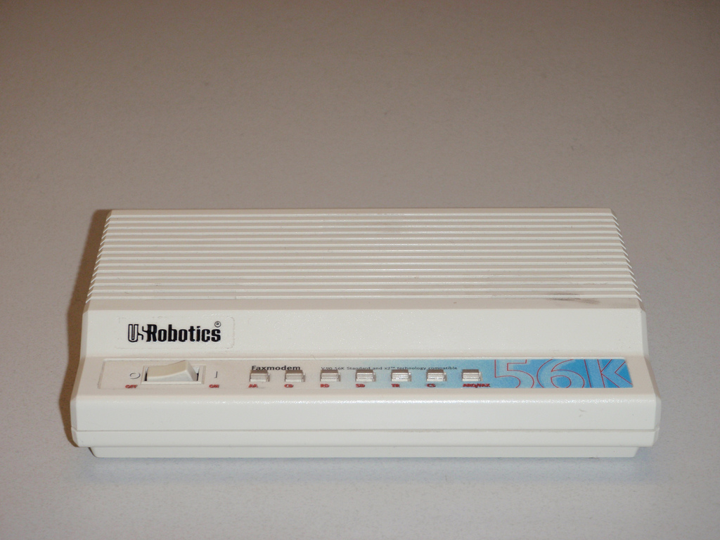
flickr.com/photos/monado/4405843023
Notes:
Thinking back to the 90s when the web grew up - this was how we got online, from a honking big desktop machine somewhere in the house - and you had to put the whole house into "online mode"...

Slide 16
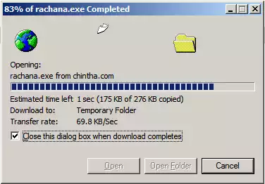
This amazing software
Notes:
By yelling to the whole house, "Don't pick up the phone!" or it would kill the connection. We used to KNOW we were online. But now, in the broadband era, we don’t even think about desktop connectivity - the network is like oxygen. Ajax got us to "good enough" because we were always connected.

Slide 17

Notes:
we’ve become used to ALWAYS being online - we see this cute little Downasaur when we’re not, and it’s a disaster. [Just ask my daughter, when the wifi goes out.]

Slide 18

Lie-Fi
Notes:
But mobile phones frequently aren't online - they exist in a Schrödinger’s Cat state of cell network connectivity. Even when you have four bars, they might not have a live connection. It’s not just “no connection” that cause us a problem and breaks the user experience, it is slow and intermittent connections that effect users just as much.

Slide 19
Reliability means never showing the Downasaur
Notes:
But still, mobile apps never show us this cute guy. Nothing on my homescreen (except Chrome) shows this. In order to for web apps to earn place on homescreen, we need to make them reliable, even when the network isn’t.

Slide 20
58%
Sessions
Bounce rate
bounce
180,000
rate
58
140,000
45
100,000
32
Sessions
Bounce rate (%)
60,000
19
20,000
20%
6
13%
bounce
rate
0
bounce
0
rate
2.4
2.7
3.0
3.3
3.6
3.9
4.2
4.5
4.8
5.1
5.4
5.7
6.0
6.3
6.6
6.9
7.2
7.5
7.8
8.1
8.4
8.7
9.0
9.3
9.6
9.9
Load time (in seconds)
Notes:
This isn’t just esoteric - We all know time is money. This data from SOATSA shows just how much that's true. After only a little more than three seconds, 20% of your users have abandoned the experience. I suppose I should make a joke about kids today and short attention spans, but I’m guilty of this too.

Slide 21

40%
of users abandon sites that take longer than 3 seconds to load
Notes:
Other studies show even worse results - that after 3 seconds, 40% of users abandon sites. In short, speed kills. Or, lack of speed kills.

Slide 22
60%
of world-wide mobile connections are 2G
Notes:
And on top of that, we know that globally over 60% of mobile connections are 2G. We need to do something. We need to be able to manage and build reliable sites and apps for users when connectivity doesn’t exist, when it's 2g or high-latency. It’s clear that we need to STOP relying on the network.

Slide 23
"Service Workers is to Progressive Web Apps what XMLHttpRequest is to AJAX"

Slide 24
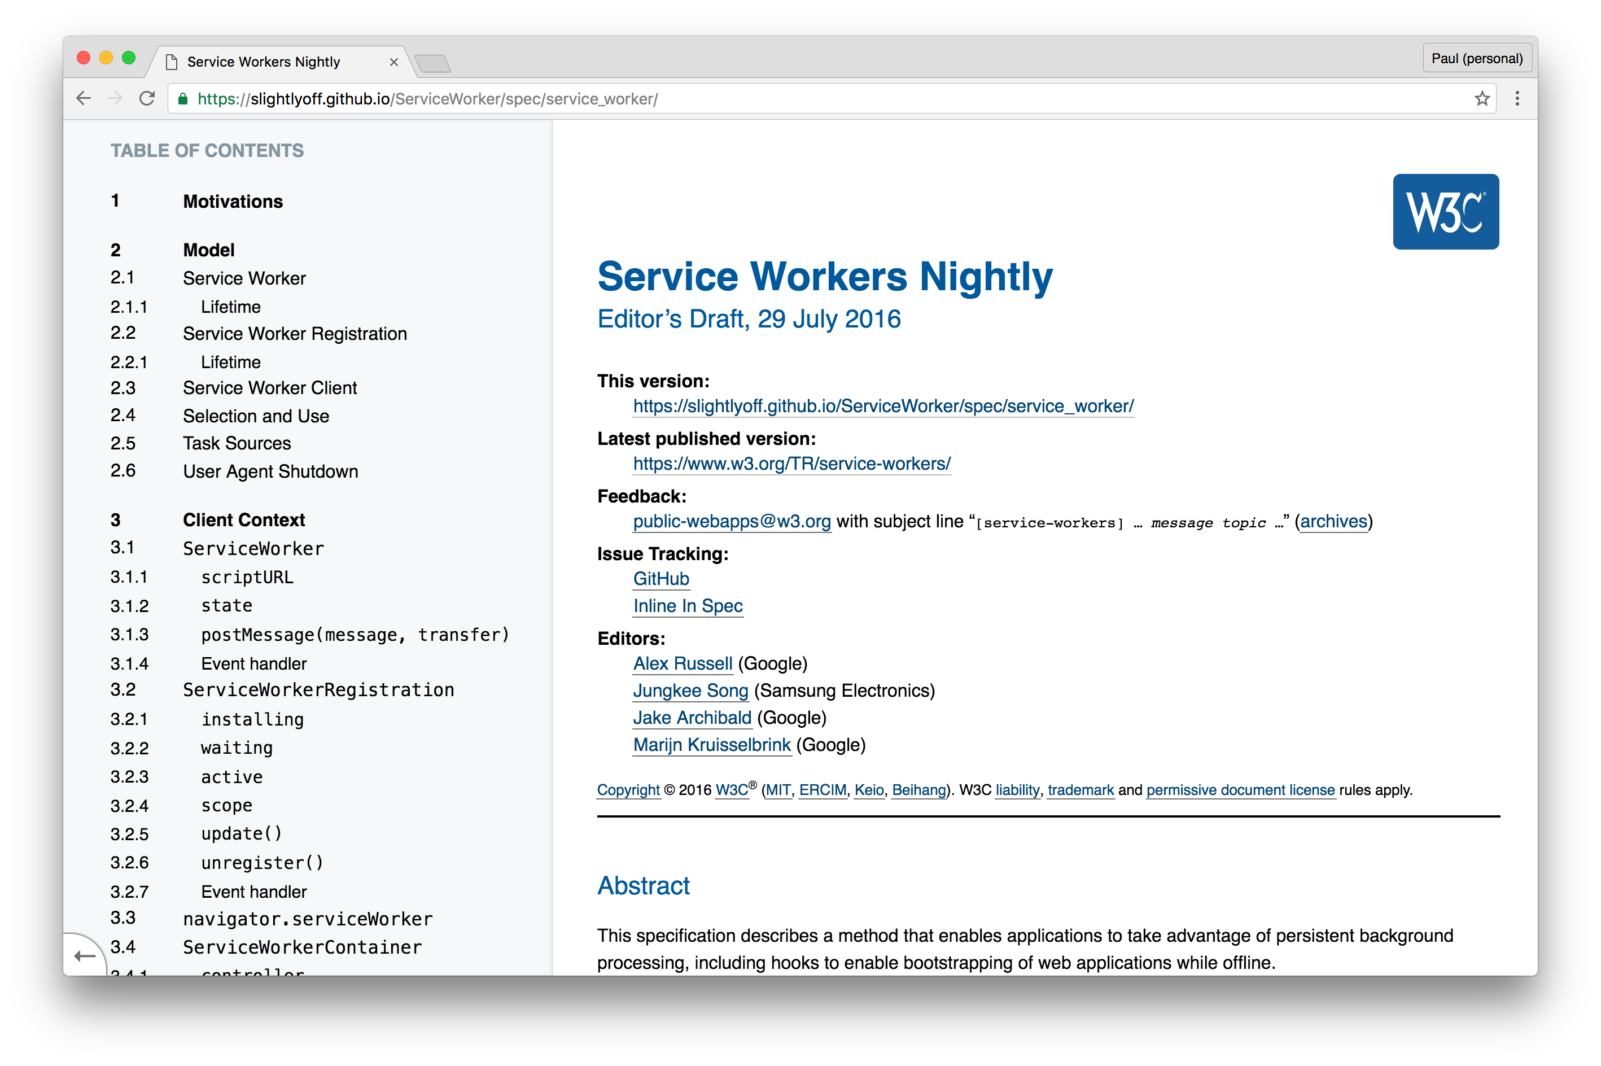
Service Worker
Notes:
The key to building instant loading and offline-capable sites is a relatively new technology called Service Workers. Who here has heard of SWs, and has a pretty good idea of what they are and why they are game-changing for the web?

Slide 25

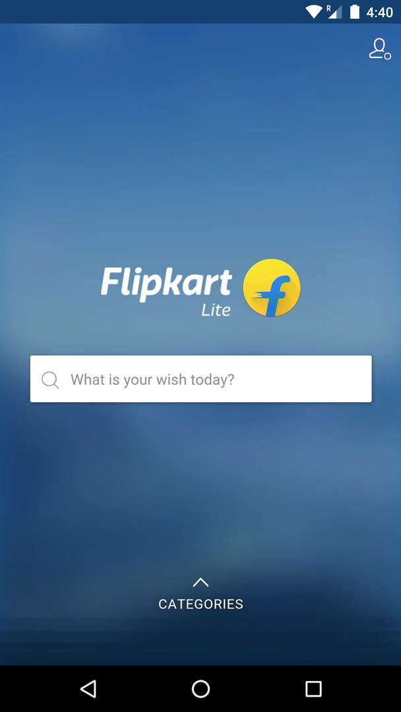


Client side proxy (written in JavaScript)
Service worker
Web server
Cache
Notes:
Aprogrammable proxy sitting between the network and the browser. But it's more than that.
When a page registers a service worker, it adds a set of event handlers to respond to things like network requests, push messages, updates to the service worker, etc. And because it's event based, it doesn't need to be resident in memory unless it's handling one of those events.

Slide 26
Service Worker Life Cycle
Register
Install
Adds app-like lifecycle to a page
Wakes up only when the OS says
Activated
Error
Only responds to system events
Idle
Active
Terminated
Notes:
I'll say it again, because I think it's important, it's not consuming any system resources until it's been woken up to handle one of the events.
In fact, even if the browser is closed, the OS can wake up a service worker. We're no longer limited to the model where an “app must be loaded in an active tab” to be useful.
This is important because it introduces an app-like lifecycle for web apps.

Slide 27
Service Worker Life Cycle
Register
Install
Adds app-like lifecycle to a page
Wakes up only when the OS says
Activated
Error
Only responds to system events
Idle
Active
Terminated
Notes:
When a service worker is first registered, it fires an "install" event which we can then use to pre-fetch the resources we need for our app and cache them locally This is like “install-as-you-go”.
In effect, we’re running a fully scriptable install (much like a native app); no bulky zipfiles and we have file-level control over what is fetched, how its cached and how it is updated.

Slide 28
Service Worker Life Cycle
Register
Install
Adds app-like lifecycle to a page
Wakes up only when the OS says
Activated
Error
Only responds to system events
Idle
Active
Terminated
Notes:
Then, once the service worker has been activated, we now have full control over how the system services your app’s resources. We can inspect network requests, rewrite them, get a response from the network, respond with one of the resources we pre-fetched when the service worker was installed. We can even synthesize our own response.
All of this is completely transparent to the user - in fact, a well-constructed Service Worker can function as just a very smart caching system, and be entirely transparent to the rest of your app; it is just a progressive enhancement of the network and cache, choosing smarter ways to respond to requests.
It gives us the ability to make our apps reliable, even when the network isn't because we have full control over the response.

Slide 29
Service Worker
is for the SECOND load.
Notes:
In fact, on the topic of “Service Worker is a progressive enhancement”, it’s important to understand that the FIRST time you’re loading the page, it’s still going to be loading from the network - the index page has already been retrieved from the network, of course, and the page’s resources will kick off downloading normally. The Service Worker will come into play on subsequent loads, not the first load. Though, there is one caveat to that, I'll cover that in a moment.
Let's dive in and take a look at the life cycle of a service worker.

Slide 30
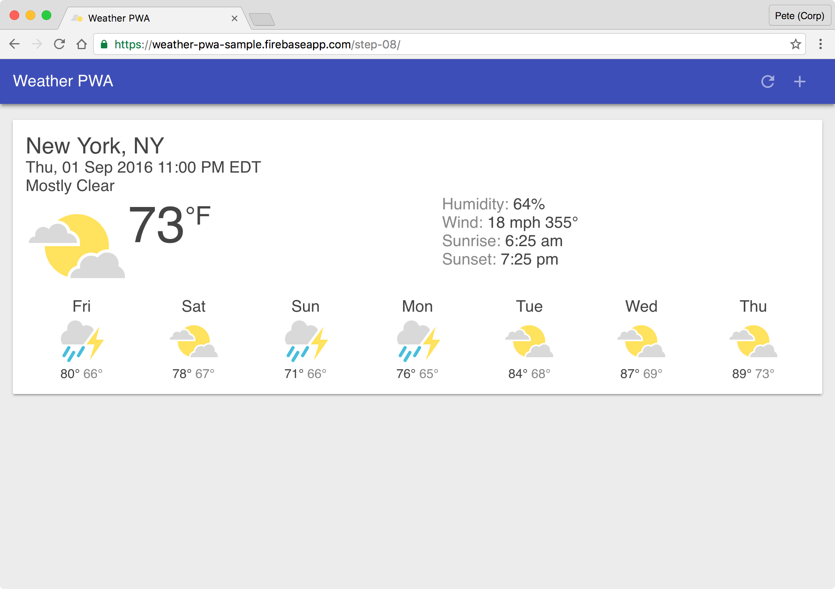
Life Cycle of a Service Worker
Installing the Service Worker
install
idle
1st Page Load
Notes:
When the page is first loaded, it registers a service worker for a specific scope, we'll get into scopes in a few minutes, but for now, think of it as the set of pages the service worker will handle.
[CLICK] An install event is then fired, and the code in your install handler is executed. [CLICK] Then, the service worker goes to idle, essentially sitting there quietly.

Slide 31
Life Cycle of a Service Worker
Installing the Service Worker
activated
check for update
2nd Page Load
Notes:
When the page is reloaded, or you hit another page covered by the service worker, the service worker becomes activated, ready to handle all of its events.
At the same time, [CLICK] the browser also makes an asynchronous request to the server to see if the service worker has changed since it was last retrieved. Good so far?

Slide 32
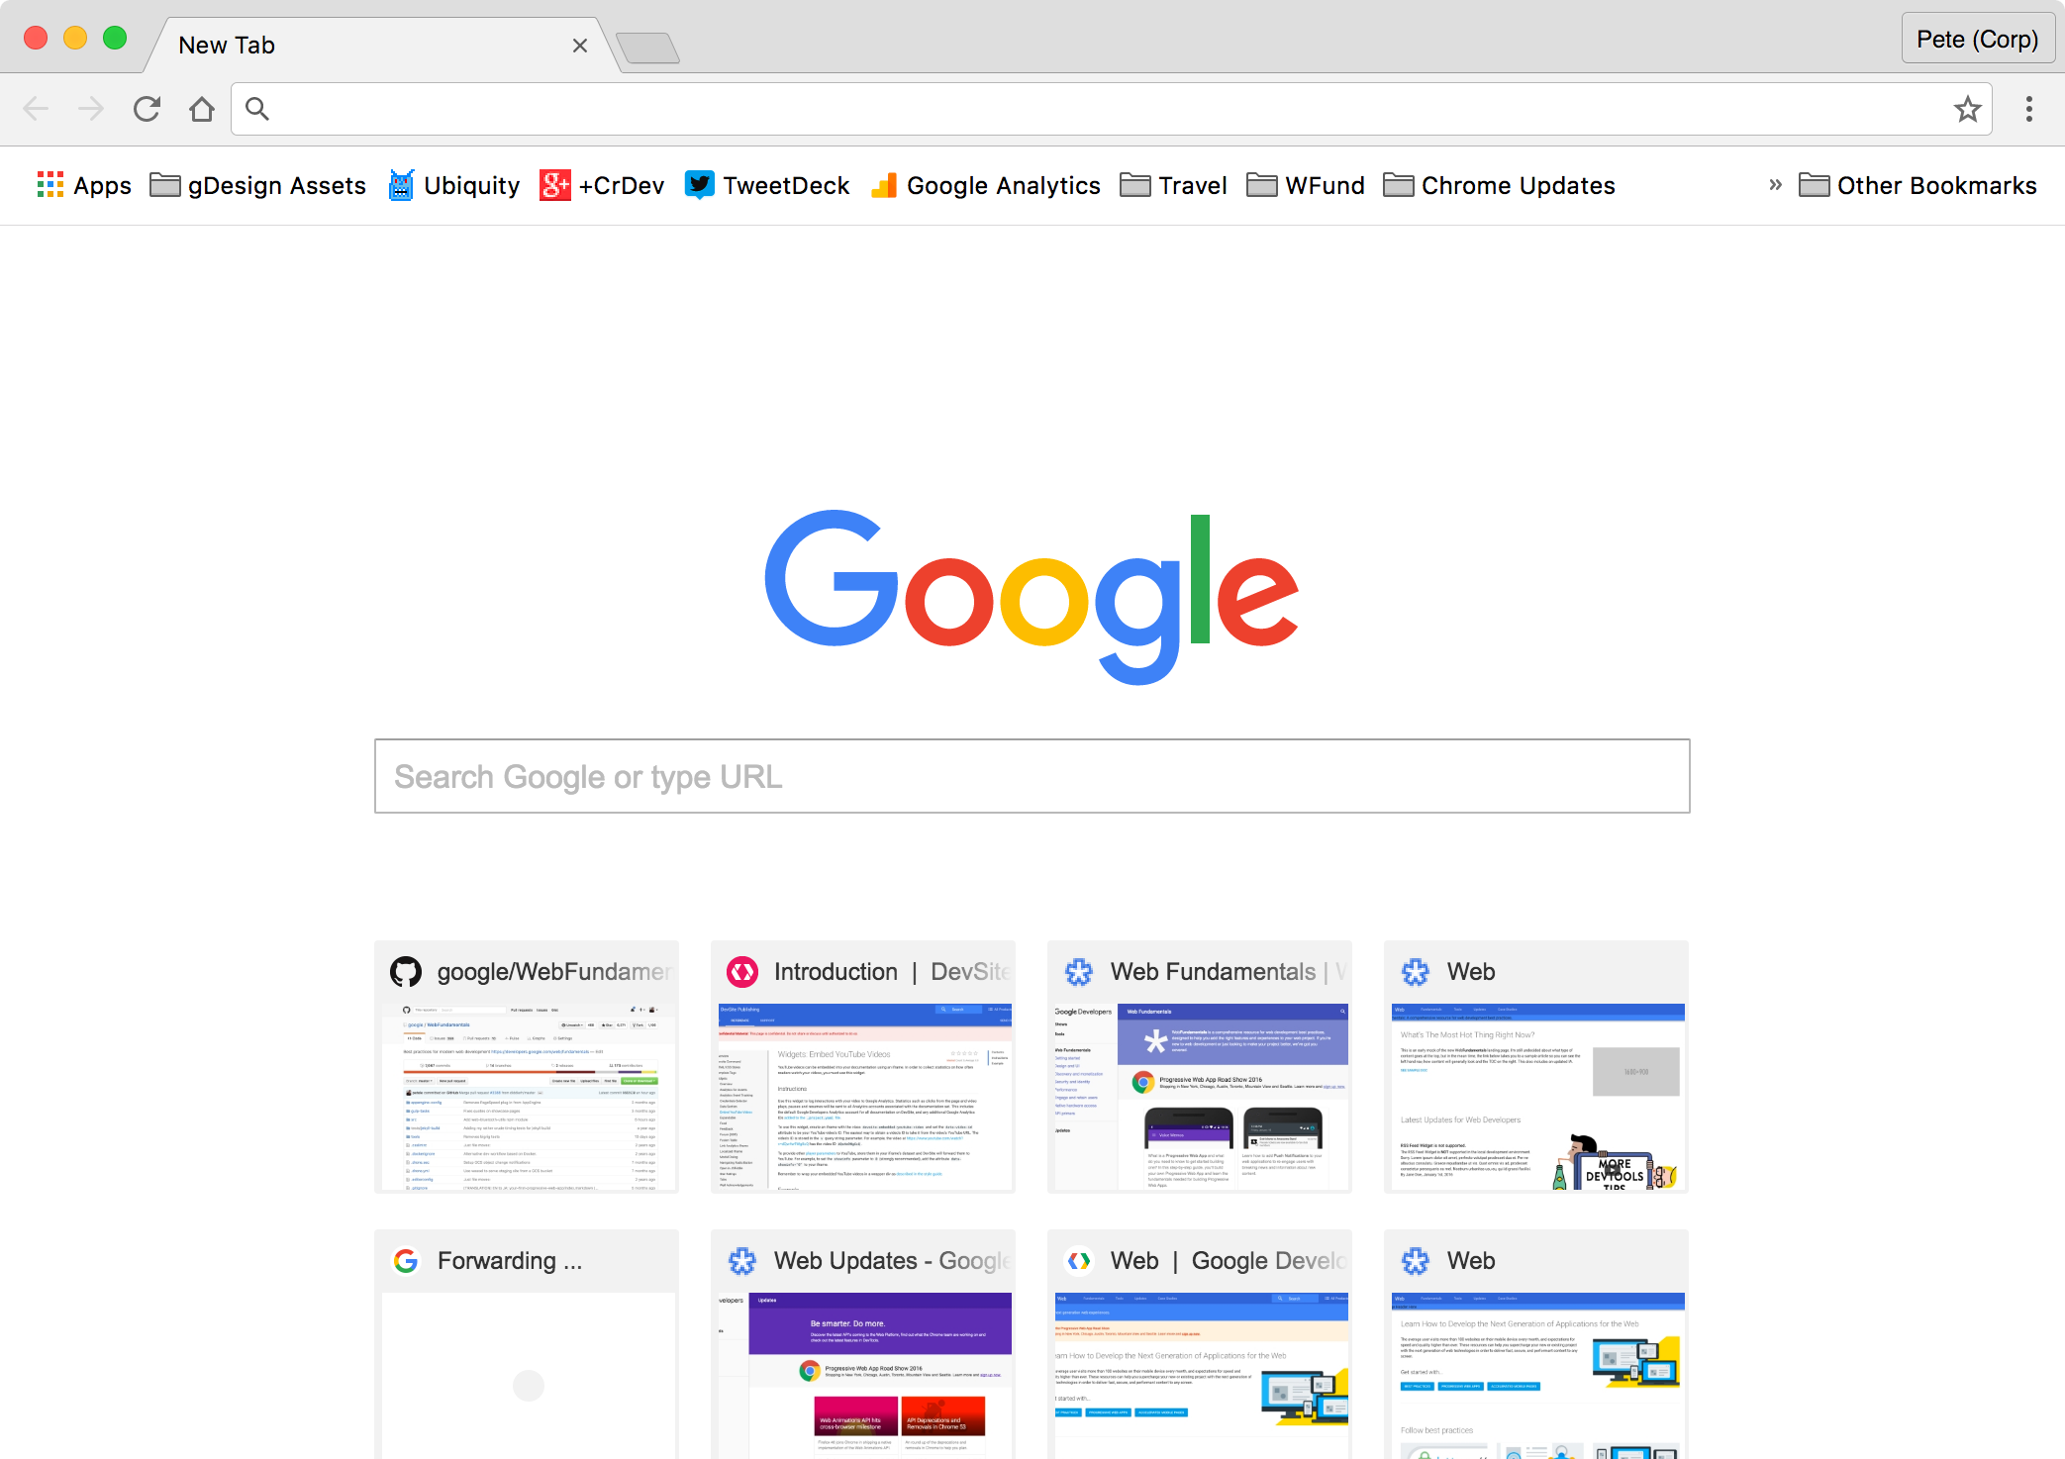
Life Cycle of a Service Worker
Installing the Service Worker
activated
idle
terminated
Close Page
Notes:
Once the service worker has handled all of the events, [CLICK] it goes to idle, and eventually it's terminated, ready to spin up again when any new events come in.

Slide 33
Life Cycle of a Service Worker
Updating a Service Worker
activated
check for update
Load Page with Service Worker
Notes:
Let's keep going with our previous example and see how a service worker gets updated. Since we've already been to the page, the service worker is already installed and is immediately activated. [CLICK] Then, just like before, the browser checks with the server to see if the service worker has changed, and this time, it has.

Slide 34
Life Cycle of a Service Worker
Updating a Service Worker
activated
check for update
install
idle
Load Page with Service Worker
Notes:
The new service worker is downloaded and installed - but it goes to idle and the original service worker is still activated. Our original service worker is still handling requests. In fact, our original service worker will remain active and serving requests until all of the clients using it have been closed, or until you use self.skipWaiting and self.clients.claim - we'll dive into those more in a second.

Slide 35
Life Cycle of a Service Worker
Updating a Service Worker
activated
check for update
install
idle
Load Page with Service Worker
Notes:
This is important to remember as you're working on your own service workers. This isn't a problem for users, but as a developer, working on your own service worker, you may find yourself with multiple service workers installed and waiting, because the original one, hasn't been terminated yet.

Slide 36
Implementing a simple Service Worker
Notes:
Enough theory, let's take a look at how to implement our own service worker.

Slide 37
Register the Service Worker
Register
Install
Activated
Error
Idle
Active
Terminated
Notes:
The first step is registering a service worker in the web page.

Slide 38
Register the Service Worker
if ('serviceWorker' in navigator) {
navigator.serviceWorker.register('/service-worker.js')
.then(function(reg) {
console.log('Service Worker Registered', reg);
})
.catch(function(err) {
console.log('Error registering Service Worker', err);
});
}
Notes:
In our index page we will place a small piece of logic - first we check for the presence of the serviceWorker API in our browser, then…

Slide 39
Register the Service Worker
if ('serviceWorker' in navigator) {
navigator.serviceWorker.register('/service-worker.js')
.then(function(reg) {
console.log('Service Worker Registered', reg);
})
.catch(function(err) {
console.log('Error registering Service Worker', err);
});
}
Notes:
if it is available we register the service worker by calling navigator.serviceWorker.register with a simple reference to the location of the service worker javascript file.

Slide 40
Add an install Event Handler
Register
Install
Activated
Error
Idle
Active
Terminated
Notes:
Next, we need to handle the install event, which is fired after the service worker javascript file has been downloaded and parsed.

Slide 41
Add an install Event Handler
self.addEventListener('install', function(event) {
return self.skipWaiting();
});
Notes:
Let's start with something basic. Remember earlier I mentioned that when a service worker is installed the first time, it doesn't take immediate control of the page, you have to wait for the page to be reloaded. Well, there's a way around that. Calling self.skipWaiting tells the service worker you want it to skip waiting, and go right to work.

Slide 42
Pre-fetch the App Resources
Register
Install
Activated
Error
Idle
Active
Terminated
Notes:
We'll use the install event to pre-fetch the resources we need, and cache them in the local cache, ensuring that the files can be loaded instantly and reliably.
In effect, this install event handler is your opportunity to have a fully scriptable install process, just like a native app; you have absolute control over what resources are pre-fetched and how they are cached.

Slide 43
Pre-fetch the App Resources
var cacheName = 'app-shell-cache-v1';
var filesToCache = ['/', '/index.html', ...];
self.addEventListener('install', function(event) {
event.waitUntil(
caches.open(cacheName).then(function(cache) {
return cache.addAll(filesToCache);
}).then(function() {
return self.skipWaiting();
})
);
});
Notes:
First, let's open up a cache object, referenced by cacheName.

Slide 44
Pre-fetch the App Resources
var cacheName = 'app-shell-cache-v1';
var filesToCache = ['/', '/index.html', ...];
self.addEventListener('install', function(event) {
event.waitUntil(
caches.open(cacheName).then(function(cache) {
return cache.addAll(filesToCache);
}).then(function() {
return self.skipWaiting();
})
);
});
Notes:
Then, we'll use cache.addAll to retrieve the resources we've listed in filesToCache and store them in our browser cache.
In a real implementation, you should make sure that you catch any exceptions here. If one of the files were to fail while downloading, the entire event fails and the service worker wouldn't be activated.

Slide 45
Pre-fetch the App Resources
var cacheName = 'app-shell-cache-v1';
var filesToCache = ['/', '/index.html', ...];
self.addEventListener('install', function(event) {
event.waitUntil(
caches.open(cacheName).then(function(cache) {
return cache.addAll(filesToCache);
}).then(function() {
return self.skipWaiting();
})
);
});
Notes:
And finally, once everything has been added, we want to call self.skipWaiting, so that our service worker takes immediate control.

Slide 46
Pre-fetch the App Resources
var cacheName = 'app-shell-cache-v1';
var filesToCache = ['/', '/index.html', ...];
self.addEventListener('install', function(event) {
event.waitUntil(
caches.open(cacheName).then(function(cache) {
return cache.addAll(filesToCache);
}).then(function() {
return self.skipWaiting();
})
);
});
Notes:
There's one other thing I want to point out, we wrapped that whole code block in event.waitUntil. That makes sure that the service worker isn't terminated or go to idle while we're waiting for the embedded promise to complete.

Slide 47
Add an activate Event Handler
Register
Install
Activated
Error
Idle
Active
Terminated
Notes:
Once everything has been cached, and our service worker has been activated, it's a good idea to clean up the cache. For example, remove any out-dated resources from the cache.

Slide 48
Add an activate Event Handler
self.addEventListener('activate', function(e) {
e.waitUntil(
caches.keys().then(function(keyList) {
return Promise.all(keyList.map(function(key) {
if (key !== cacheName) {
return caches.delete(key);
}
}));
})
);
return self.clients.claim();
});
Notes:
There are plenty of ways to do this, but in this case, we iterate over the list of keys from the cache, then delete any caches that don't match the current cache name.

Slide 49
Add an activate Event Handler
self.addEventListener('activate', function(e) {
e.waitUntil(
caches.keys().then(function(keyList) {
return Promise.all(keyList.map(function(key) {
if (key !== cacheName) {
return caches.delete(key);
}
}));
})
);
return self.clients.claim();
});
Notes:
And there's one more thing we need to do. By calling self.clients.claim, we tell the browser that we want THIS service worker to take control of all of the clients that it controls. That means we don't have to wait until any other service workers that are running terminate, we're ready to go immediately!

Slide 50
Not Done Yet…
Register
Install
Activated
Error
Idle
Active
Terminated
Notes:
But at this point if you were to go offline…

Slide 51
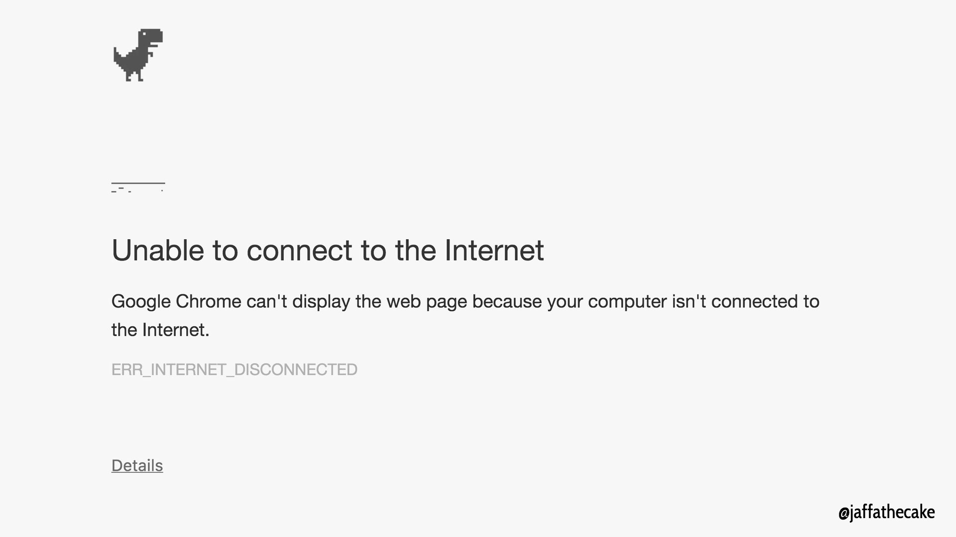

Notes:
…you would still get the dreaded “Downasaur”. But why? We haven't added a fetch event handler yet, allowing us to respond to the network requests that are made by our page.

Slide 52
Add a fetch Event Handler
self.addEventListener('fetch', function(e) {
e.respondWith(
caches.match(e.request).then(function(response) {
return response || fetch(e.request);
})
);
});
Notes:
Let's assume that every required resource for our app is already in the cache; but if it is not we'll just go out to the network to fetch it. When a network request is made from our web page our Service Worker wakes up, the `fetch` event is triggered.

Slide 53
Add a fetch Event Handler
self.addEventListener('fetch', function(e) {
e.respondWith(
caches.match(e.request).then(function(response) {
return response || fetch(e.request);
})
);
});
Notes:
Next, we check to see if the requested resource is in the cache.

Slide 54
Add a fetch Event Handler
self.addEventListener('fetch', function(e) {
e.respondWith(
caches.match(e.request).then(function(response) {
return response || fetch(e.request);
})
);
});
Notes:
If it is, we return the version from the cache.

Slide 55
Add a fetch Event Handler
self.addEventListener('fetch', function(e) {
e.respondWith(
caches.match(e.request).then(function(response) {
return response || fetch(e.request);
})
);
});
Notes:
Otherwise, we request it from the network and return that.

Slide 56
Ready to Go!
Register
Install
Activated
Error
Idle
Active
Terminated
Notes:
We now have a reliable experience that loads almost instantly. Our app will work whether we're online or offline, and it'll load extremely quickly because we've eliminated any potential network latency.
Our last step is to let the page know that the service worker is now registered and ready to go. This is helpful if you want to indicate to the user that the page is offline capable.

Slide 57
Scope
if ('serviceWorker' in navigator) {
navigator.serviceWorker.register('/service-worker.js')
.then(function(reg) {
console.log('Service Worker Registered', reg);
})
.catch(function(err) {
console.log('Error registering Service Worker', err);
});
}
Notes:
Earlier, I mentioned scopes. One of the cool things about a service worker is that you don't need to register it on every page you want to use it. You only need to register it once, and any page within the scope will be handled by the service worker.
The easiest way to define a scope is simply based on where the service worker is served from.

Slide 58
Scope
if ('serviceWorker' in navigator) {
navigator.serviceWorker.register('/service-worker.js')
.then(function(reg) {
console.log('Service Worker Registered', reg);
})
.catch(function(err) {
console.log('Error registering Service Worker', err);
});
}
Notes:
I recommend that you serve your service worker from the server root, that means every resource requested will be handled by the service worker.

Slide 59
Scope
if ('serviceWorker' in navigator) {
navigator.serviceWorker.register('/scripts/s-worker.js')
.then(function(reg) {
console.log('Service Worker Registered', reg);
})
.catch(function(err) {
console.log('Error registering Service Worker', err);
});
}
Notes:
If you put it in your scripts directory, only resources served from scripts will be handled by the service worker. In this case, unless the page registering the service worker is also in scripts, it won't be handled by the service worker.
[CLICK] I did this my first time, and it SUCKED, so don't make the same mistake I made.

Slide 60
Scope
if ('serviceWorker' in navigator) {
navigator.serviceWorker.register('/service-worker.js')
.then(function(reg) {
console.log('Service Worker Registered', reg);
})
.catch(function(err) {
console.log('Error registering Service Worker', err);
});
}
Notes:
Putting the service worker in your server root gives you the first crack at responding to any network requests, and helps to ensure your app is reliable and loads almost instantly.

Slide 61
Caching strategies
You are in control of the network
Notes:
The magic a Service Workers provides, is that YOU are in control. You get to decide what gets cached, how it's cached and how it should be returned to the user.
I've shown you the cache first with network fallback strategy, it provides a fast, reliable experience for our users. There are several different caching strategies, and depending on your app scenario, you might want to use a different one. Or even multiple strategies for different kinds of requests. Let's take a look at some of the different strategies.

Slide 62
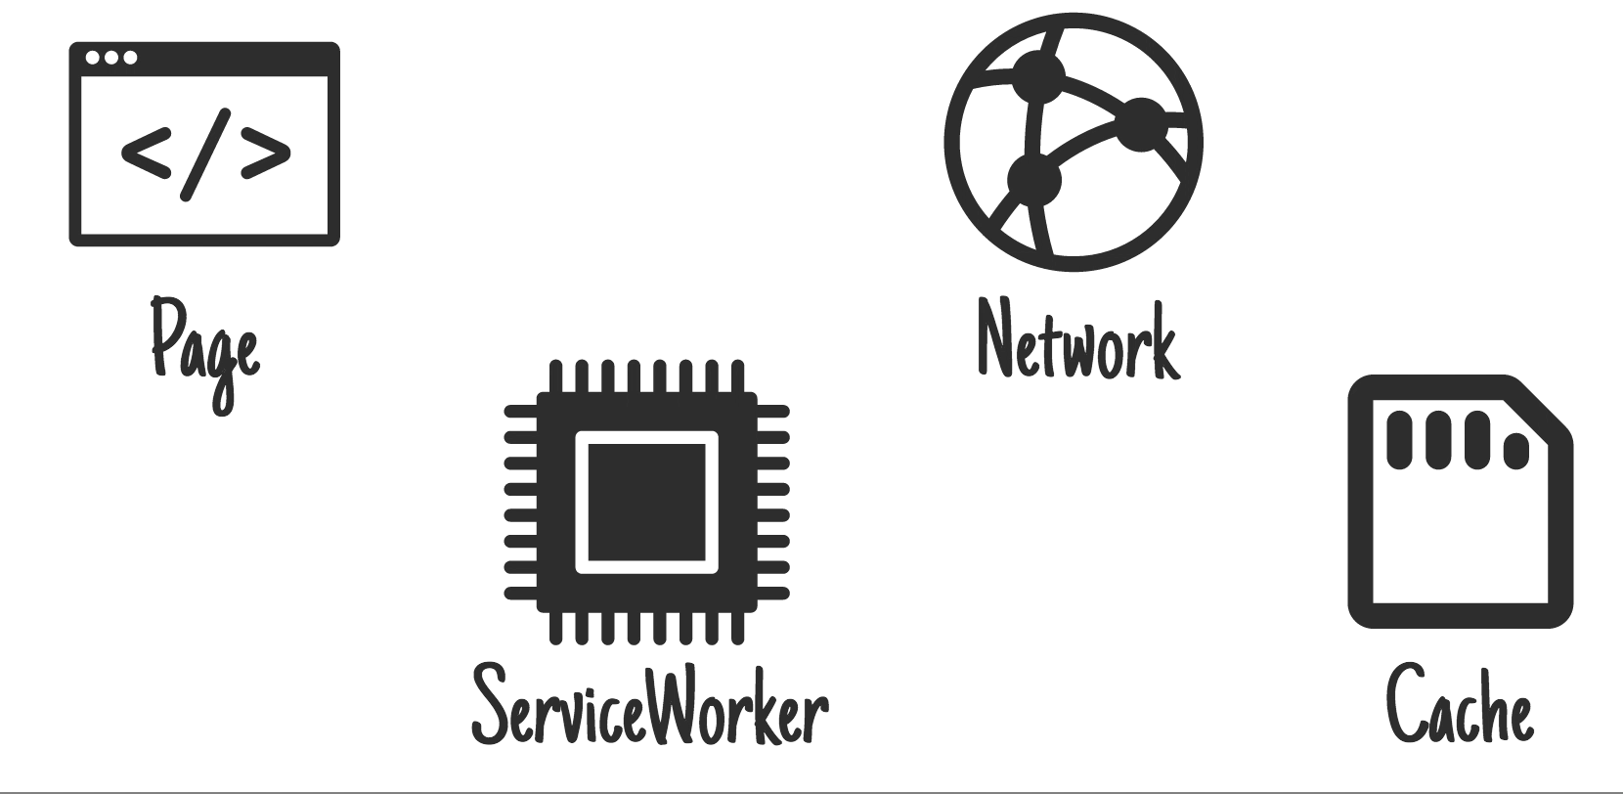
Cache, Falling Back to Network
Notes:
The cache first with network fallback strategy we’ve laid out is pretty straightforward - always go to the cache first. If the request matches a cache entry, respond with that. Otherwise try to fetch the resource from the network. This option is good for resources that don't change, or have some other update mechanism. It will give you a very fast response - since objects come out of the cache directly - but it doesn’t update. On the negative side, if an item isn't in the cache, it's not automatically added after its retrieved from the network.

Slide 63
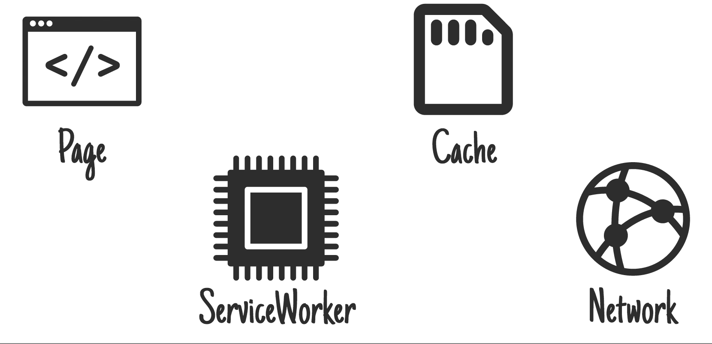
Network, Falling Back to Cache
Notes:
Network, falling back to cache means you give online users the most up-to-date content, but offline users get an older cached version. If the network request succeeds you'll most-likely want to update the cache entry.
However, this method has flaws. If the user has an intermittent or slow connection they'll have to wait for the network to fail before they get the perfectly acceptable content already on their device. This can take an extremely long time and is a frustrating user experience.

Slide 64
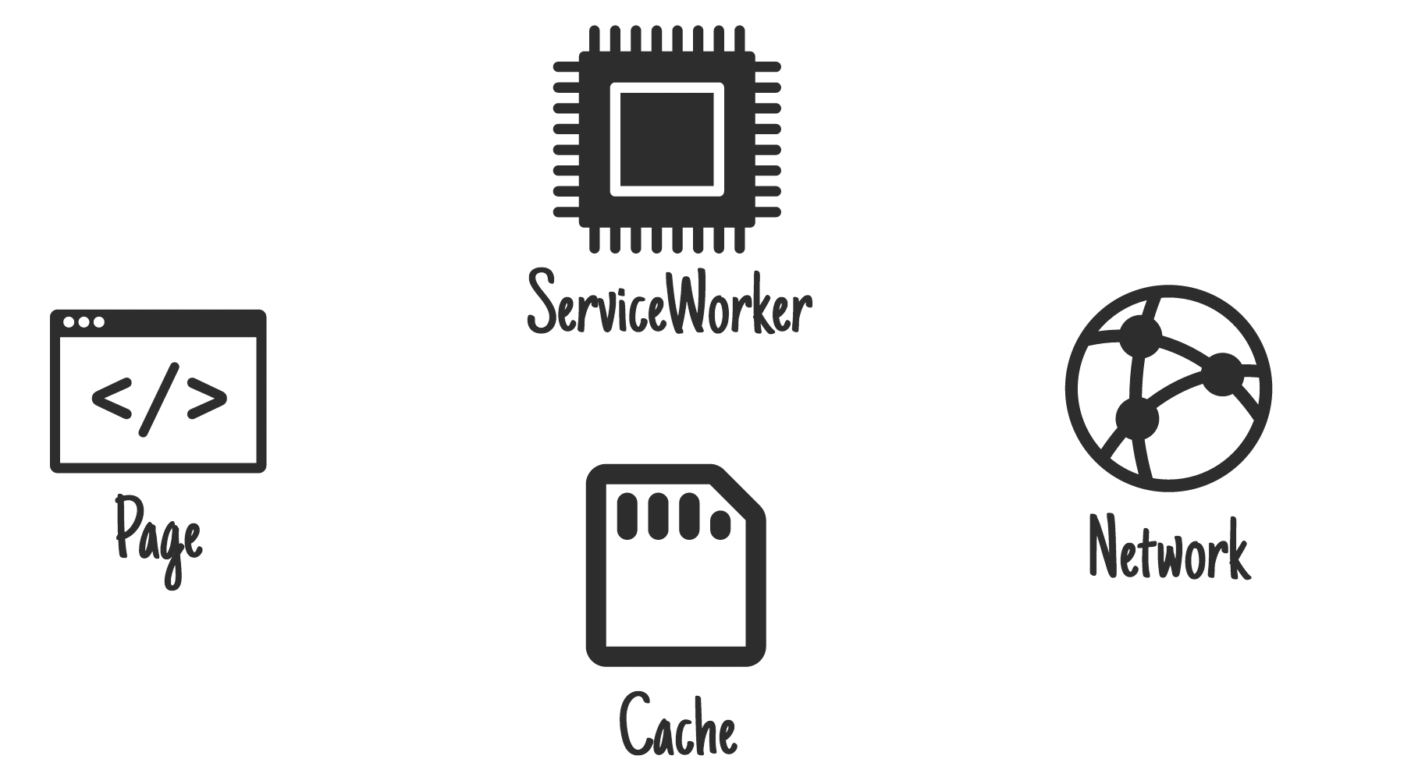
Cache then Network
Notes:
Cache, then network requires the page to make two requests, one to the cache, one to the network. The idea is to show the cached data first, then update the page when/if the network data arrives.
Sometimes you can just replace the current data when new data arrives (e.g. game leaderboard), but that can be disruptive with larger pieces of content. Basically, don't "disappear" something the user may be reading or interacting with.

Slide 65
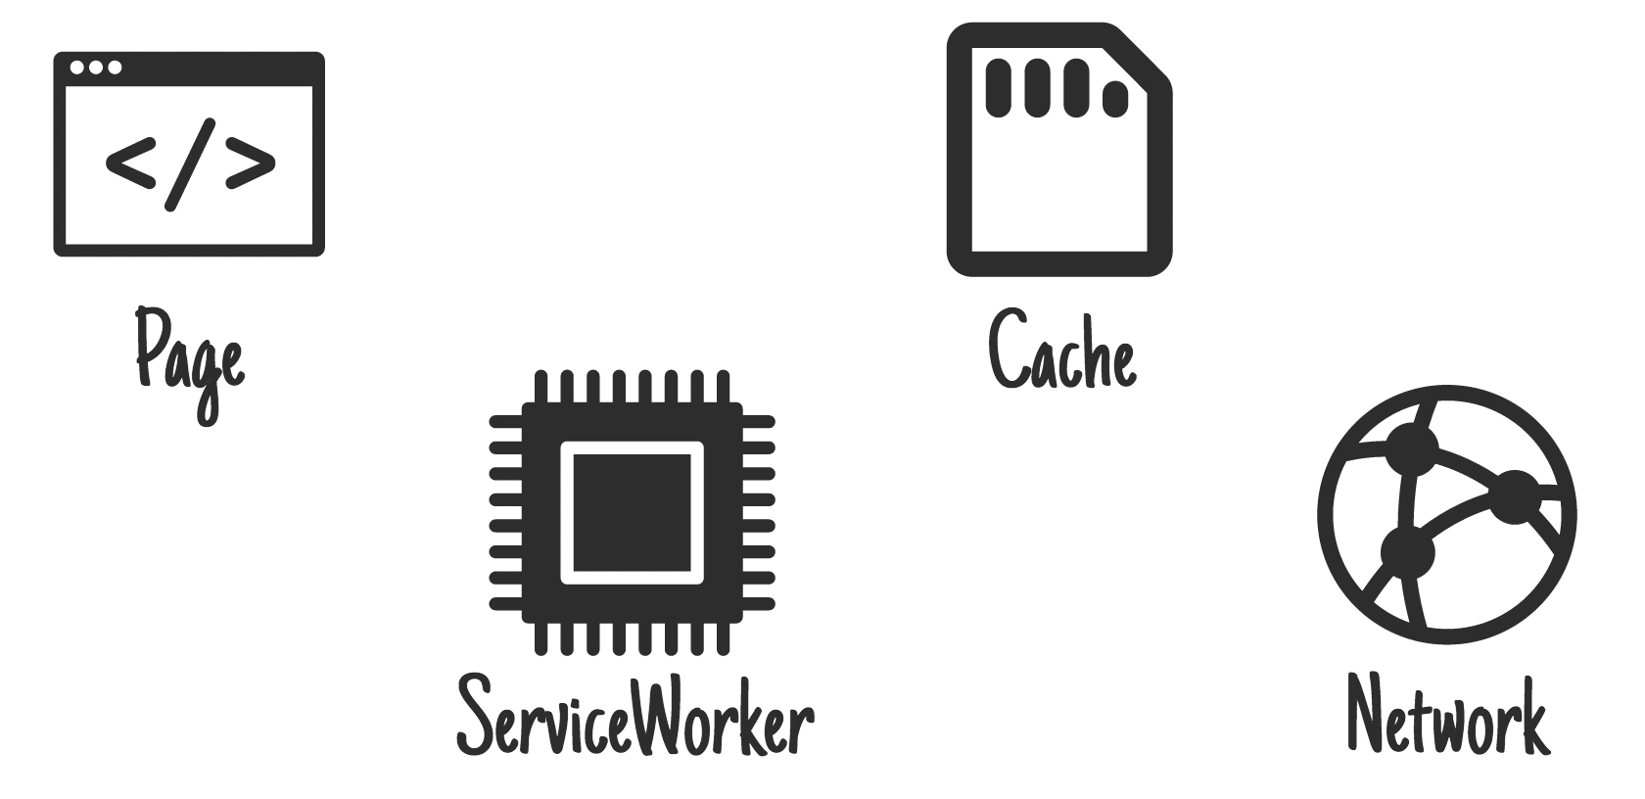
Generic Fallback
Notes:
With the generic fallback strategy, a request is made first to the cache, then the network, and if both of them fail, a second request is made to the cache for a generic page.
This is ideal for: Secondary imagery such as avatars, failed POST requests, "Unavailable while offline" page. One of my favorite uses for this is a newspaper that gives you a crossword puzzle to play while you're offline.

Slide 66
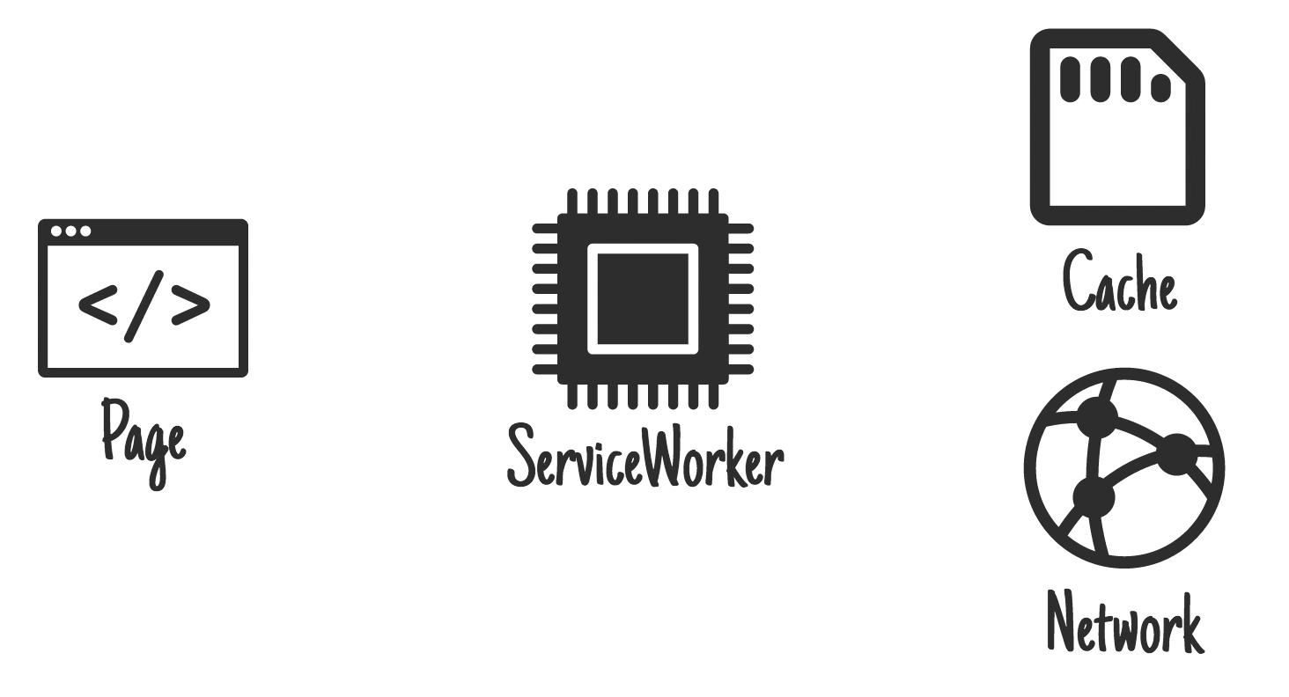
Cache and Network Race
Notes:
With some combinations of older hard drives, virus scanners, and faster internet connections, getting resources from the network can be quicker than going to disk. However, going to the network when the user has the content on their device can be a waste of data, so bear that in mind.

Slide 67

control
You are in
Notes:
And of course, there are more, cache-only, network only, service worker templating, just to name a few. But the core point here is that when it comes to caching strategies, you are in complete control over how to respond to resource requests; you can manage the network and the cache so that you can build a consistently reliable and performant solution.
image ref: https://pixabay.com/en/moog-synthesizer-moog-modular-1573329/

Slide 68
Tooling
Notes:
Because you have so much control over the network it can seem quite daunting to get started and to debug experiences, luckily there are a number of tools that can help you. We’ll have references for all this stuff at the end, so don’t worry, this is just an overview.

Slide 69
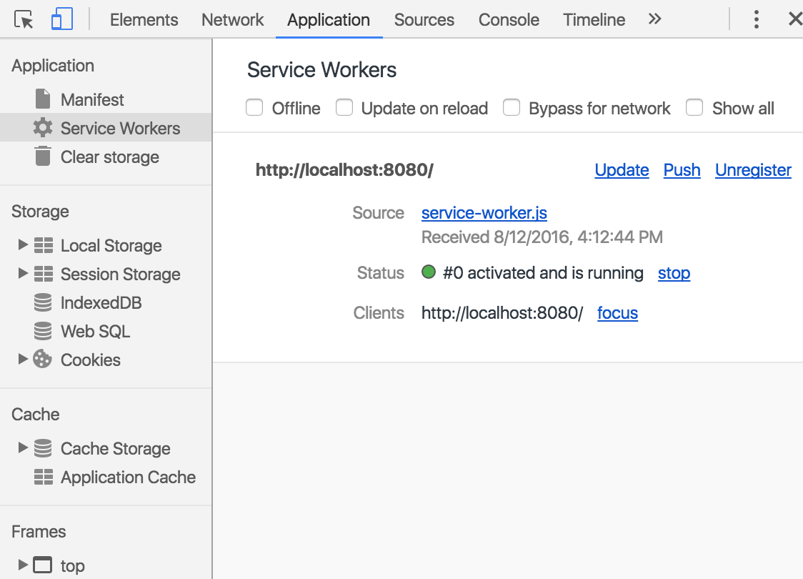
The Dev Tools Application Pane
All your service worker debugging in one place.
Notes:
While we're in the DevTools, let's take a detour to another panel that's very relevant—the brand new Application panel. This is the new, central location for debugging everything related to your service workers. We can confirm that our new service worker is running without errors.
We can check the contents of the Cache Storage that our service worker will use.
And we can also make use of the various checkboxes at the top of the page to automate common debugging tasks.
The Offline checkbox lets us simulate a network failure, so we can confirm how our service worker behaves.
The Update on Reload checkbox ensure that when we make changes to our service worker during development, refreshing the page will always put the new code into effect right away.
And finally, the Bypass for network checkbox allows us to skip the service worker's fetch handler temporarily, forcing our HTTP requests to go straight to the network.

Slide 70
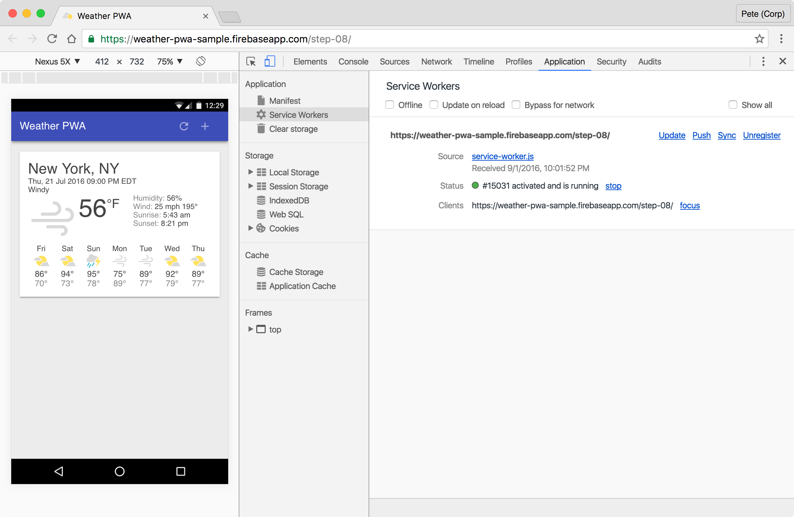
Chrome Dev Tools
Notes:
The Chrome DevTools have added a new set of tools to help you work with service workers. In the DevTools, you'll find the “Application” tab. Under the Application tab you can get access to the Manifest properties, but can also inspect the service worker, unregister it, force it to update, simulate offline behavior and more. We’re going to talk about this in depth later, in the tooling session, and also have a code lab on it.
And of course, Firefox, Opera and other browsers have similar tools for debugging service workers.

Slide 71
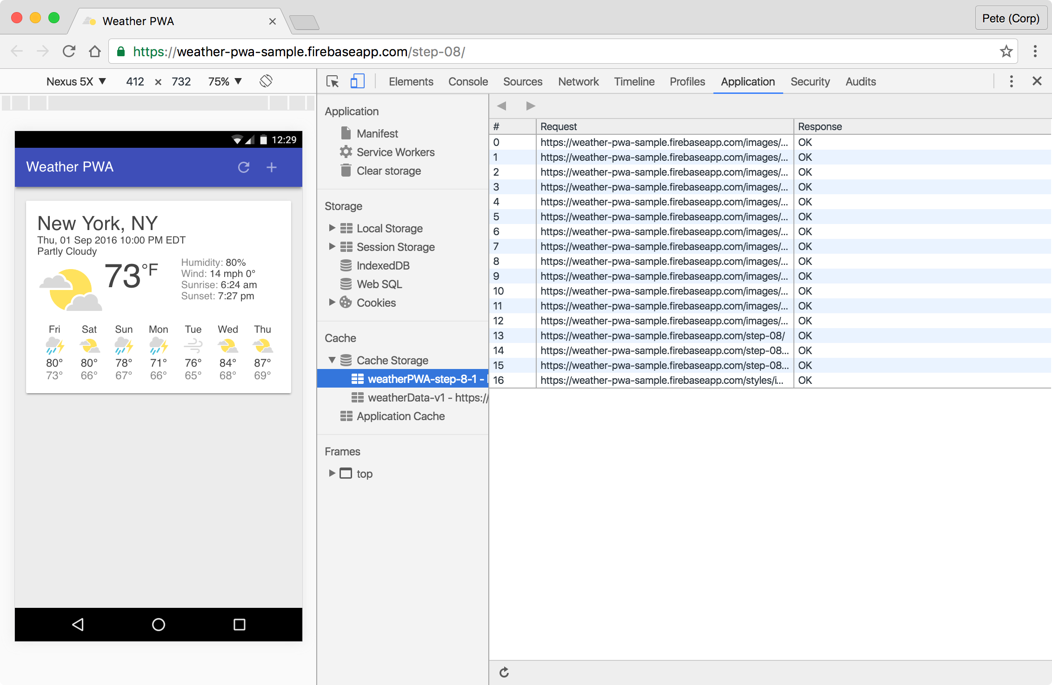
Chrome Dev Tools: the cache
Notes:
DevTools lets you inspect not only application storage like IndexedDB but also inspect cache storage.

Slide 72
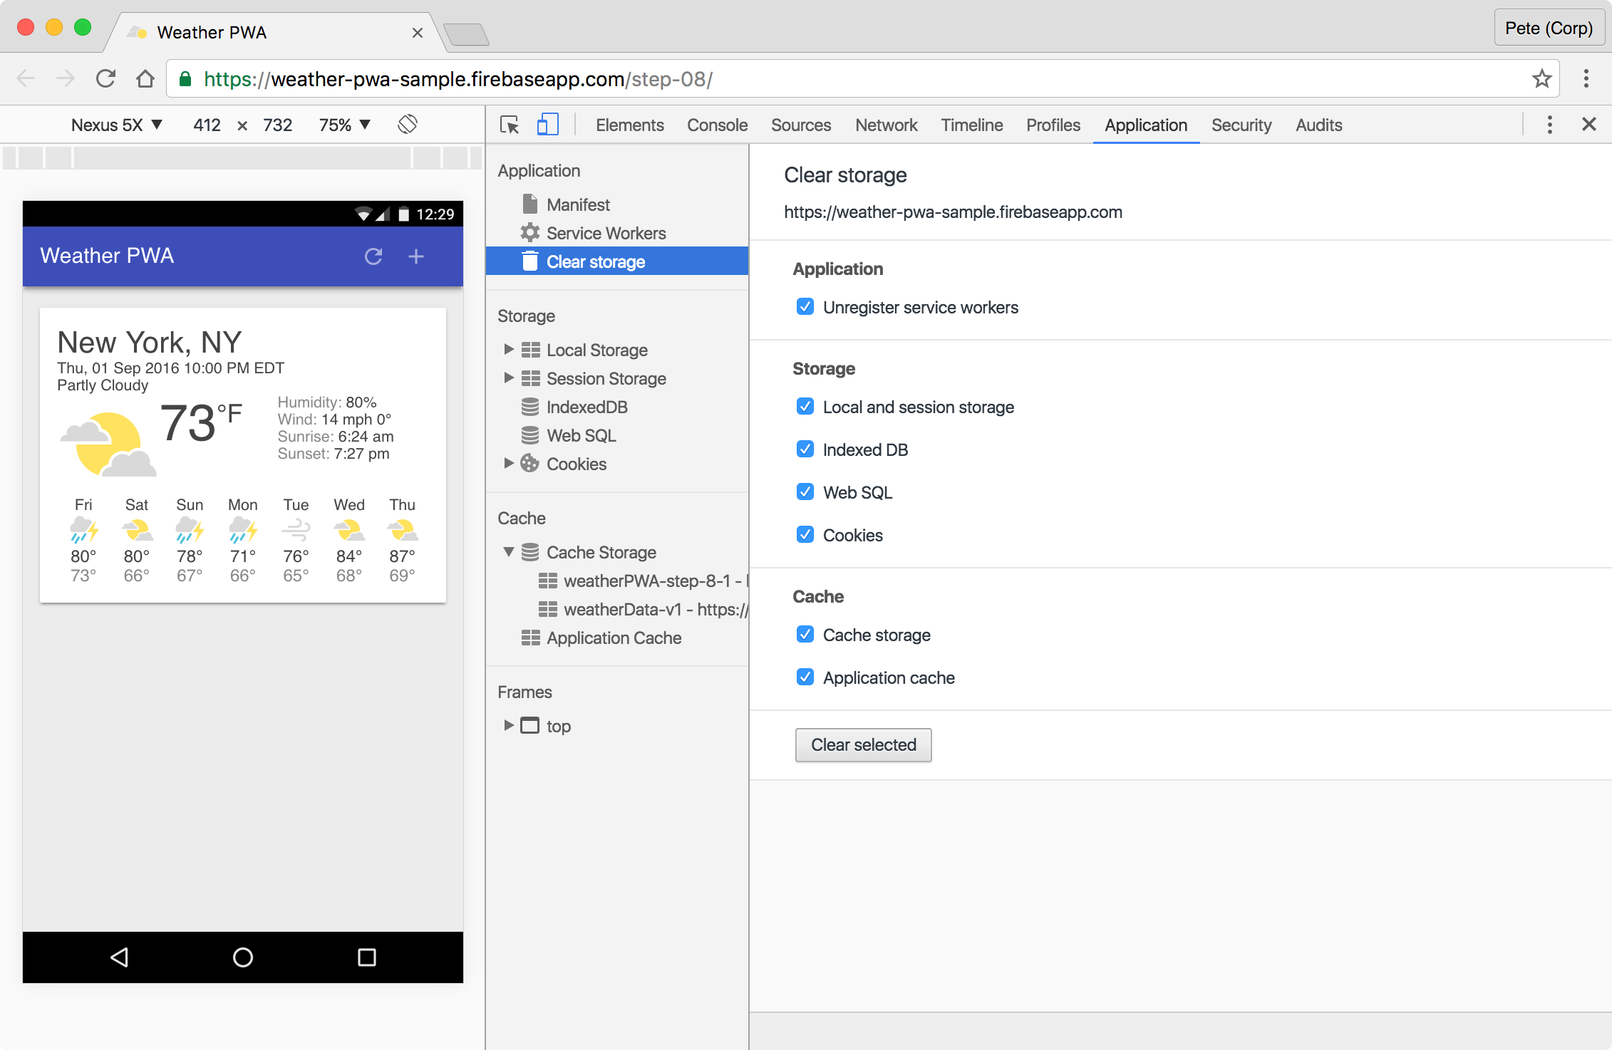
Chrome Dev Tools: the cache
Notes:
In the past, we used to recommend people use incognito windows when developing service workers because it made it easy to start fresh when you needed to. But the new clear storage pane in the Application panel simplifies things tremendously. I use this one a LOT.

Slide 73
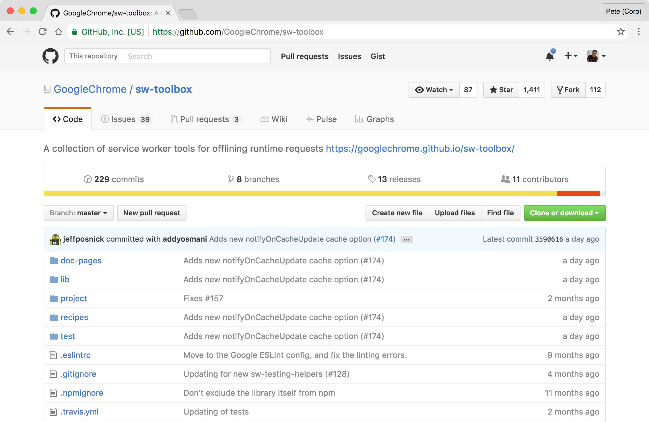
Service Worker toolbox
Notes:
Next, we have a couple of tools that can use to speed your service worker development along. Service Worker Toolbox is a library that comes with a number of pre-built Caching Strategies for your site, such as Network First and Cache First, and if you are familiar with NodeJS and Routing frameworks for URL interception you will be at home with this as it provides a very nice high level abstraction.

Slide 74
Cache first in sw-toolbox
importScripts('/sw-toolbox.js');
toolbox.router.get('/(.*)', toolbox.cacheFirst, {
origin: /\.googleapis\.com$/
});
Notes:
If you remember the code for a cache-first SW from earlier, it was a bit cumbersome to write. With Service Worker toolbox, this turns into simple declarations for cacheing strategies on multiple resources. but you are still in control of your site - it’s just a set of packaged routings and strategies.

Slide 75
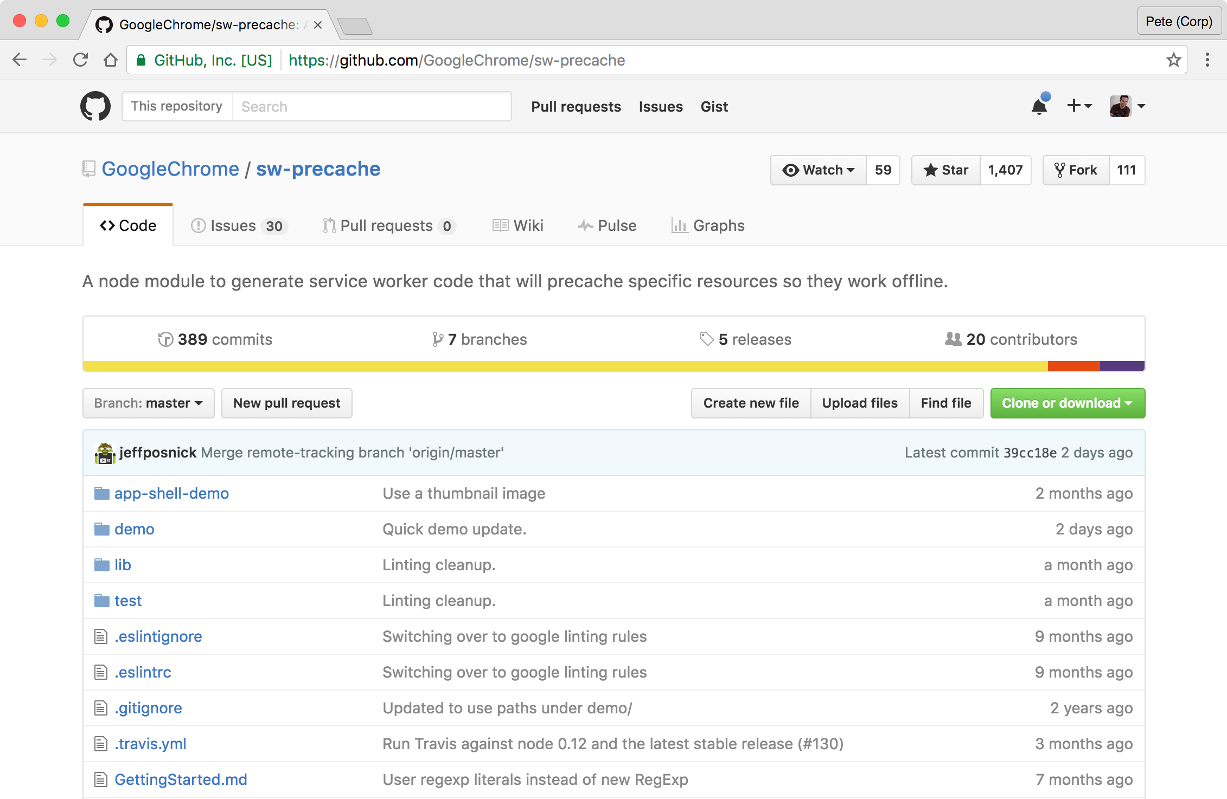
sw-precache Node module
Notes:
We also have a tool called sw-precache that help by literally writing out SW code for you.
sw-precache is a Node module that you can use in JavaScript-based build scripts, like those written with gulp, and you can use it from the command-line interface. You tell it which files you want it to cache, either through the parameters or through a JSON config file, and it will create a service worker custom-built for your app.

Slide 76
sw-precache
precache.write('service-worker.js', {
staticFileGlobs: ['**/*.{html,css}'],
runtimeCaching: [
{urlPattern: '/', handler: 'fastest'},
{urlPattern: '/api/.*', handler: 'networkFirst',
options: {networkTimeoutSeconds: 5}
},
{urlPattern: '/posts/.*', handler: 'cacheFirst'},
{urlPattern: '/styles/.*', handler: 'cacheOnly'},
{urlPattern: '/inbox.json', handler: 'networkOnly'}
]
});
Notes:
Probably easiest to give an example - this is a usage of sw-precache running in a build script. You can see how it sets up various URL patterns with different cache strategies. Then you just need to make sure you register service-worker.js in your index file.

Slide 77
APIs that require HTTPS
Service Workers
getUserMedia
Push Notifications
App Cache
Encrypted Media Extensions
Geo Location
HTTPS/2
For more information, see:
https://www.chromium.org/Home/chromium-security/prefer-secure-origins-for-powerful-new-features
Notes:
Service workers are amazing, as you’ve already heard today. They are the secret superheros behind PWAs that enable performance in the face of sketchy network conditions.
Service workers sit between the browser and the network, so they actually manage every request that comes through. And you can imagine, it’s critically important that site owners own their service workers - or they are p0wned. This is why Service Workers require HTTPS.

Slide 78
HTTPS is a crucial part of the user experience
It’s no longer for especially important or security-sensitive sites only.
Notes:
Fundamentally, HTTPS is a critical part of delivering a good user experience, everywhere.

Slide 79
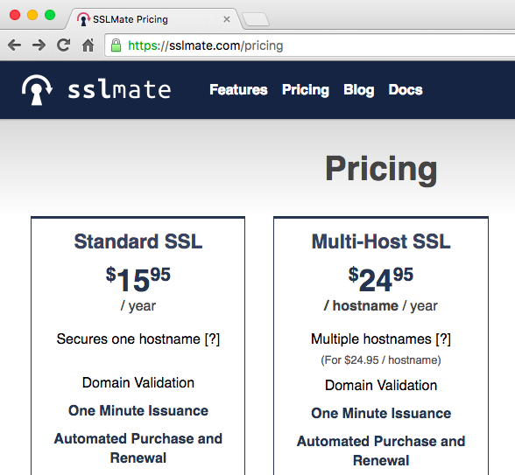
Notes:
A project called SSL mate has for many years now been offering certificates for $16. So even if you need multiple certificates or one of their fancier options, it shouldn’t break the bank.

Slide 80

Let’s Encrypt is a trademark of the Internet Security Research Group.
Notes:
A newer project called Let’s Encrypt…. offers free certificates. And both of these projects, SSL mate and Let’s Encrypt, also offer automated command line tools that help you buy and manage your certificates automatically so that they don’t expire, setup configurations, or other tasks like that. So certificates should not be the reason for employing HTTPS.

Slide 81
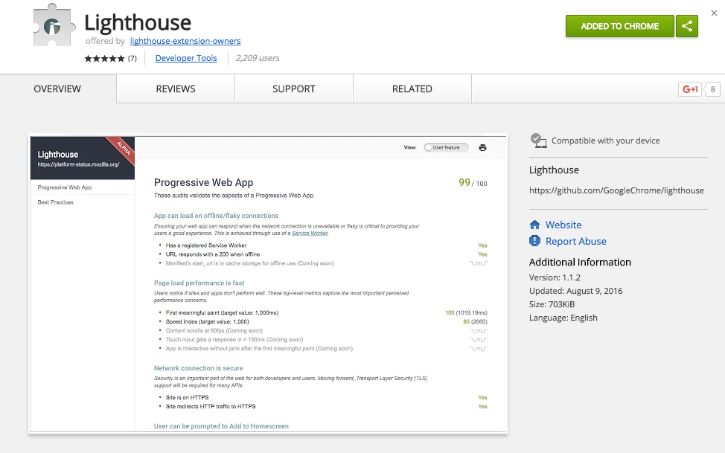
Lighthouse
Notes:
So now that we've got a feel for what the app does, let's try to figure out how we can improve the current implementation. We're going to use Lighthouse, which is a tool Google produces that automates a whole suite of diagnostic tests covering areas important for progressive web apps. This is available as a Chrome Extension…

Slide 82
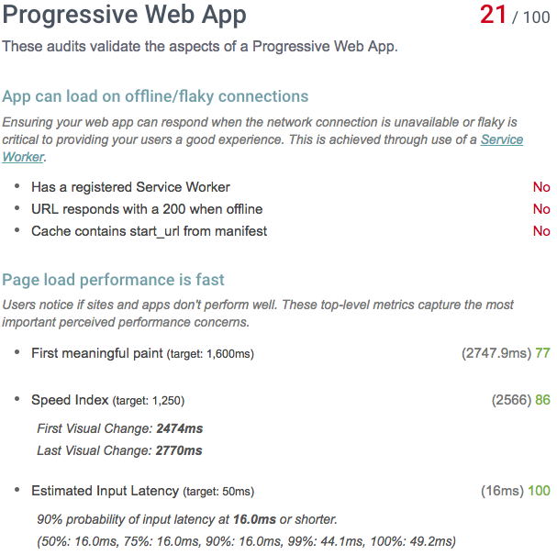
Opportunities for Improvement
Server-side rendering
Service worker
Web app manifest
Notes:
Our speed scores could be better, no content on our page when JavaScript is disabled. Both of those could be improved by introducing server-side rendering. won't respond when offline, so it needs a service worker. missing metadata/manifest. So we've got three concrete steps that we can take, and we'll walk through them each now, using Lighthouse and cross-browser testing to measure how effective our work is.

Slide 83

meow
Go build!
Notes:
With that, thank you so much; we’re going to have the codelabs.

Slide 84
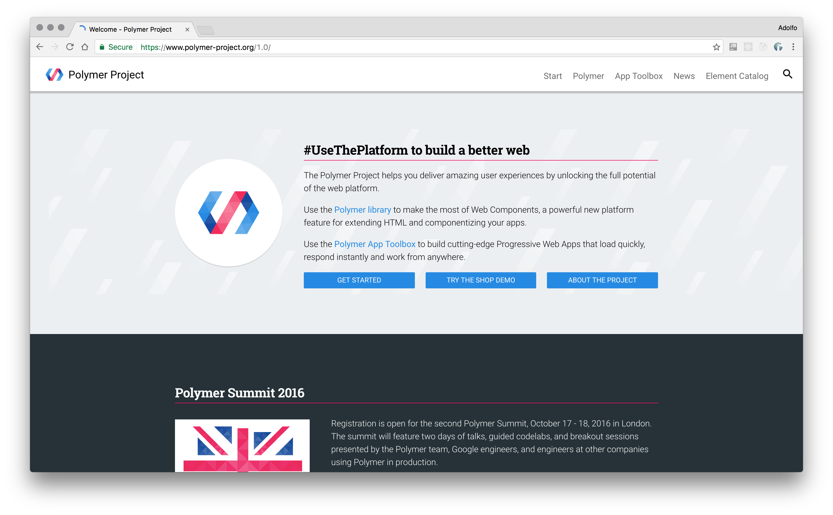
Polymer
Notes:
Man, custom elements, Local DOM. Encapsulation, Events listening,

Slide 85
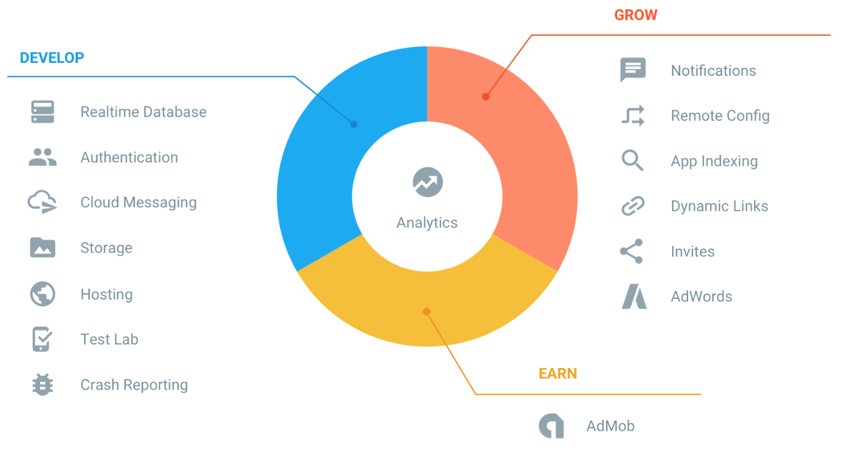
Firebase
Notes:
Just WOW

Slide 86
Workshop
Steps: goo.gl/Hj4Wiy
Solution: https://github.com/adben/gdg-nl-pwa

Slide 87



Looking for a full stack job? Contact me
Burak Yildirim - jobs@finalist.nl – 088 217 08 00
Web: finalist.nl/werkenbij
Blog: finalist.nl/techblog
Notes:
We are hiring

Slide 88
Your First Progressive Web App
https://goo.gl/9DJRJq
Debugging Service Workers
https://goo.gl/suGNRb
Push Notifications
https://goo.gl/NTwlNv
Code Labs

